Slide 1
Random forests
Random Forest is a machine learning algorithm that uses many decision trees to make better predictions. Each tree looks at different random parts of the data and their results are combined by voting for classification or averaging for regression which makes it as ensemble learning technique. This helps in improving accuracy and reducing errors.

Slide 2
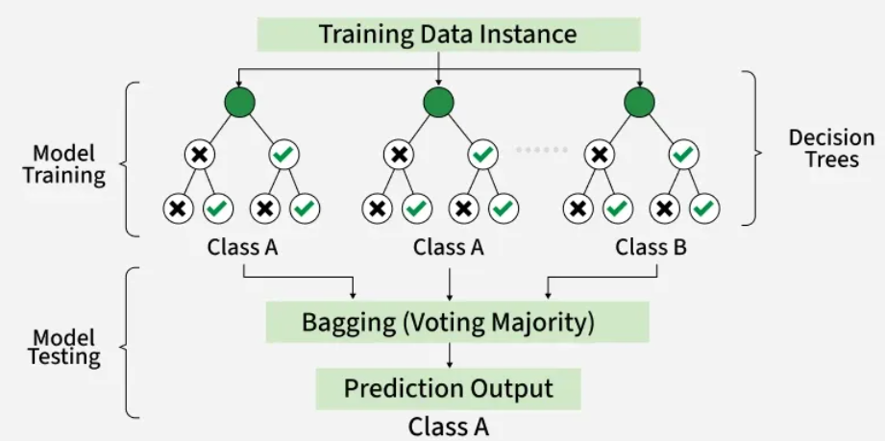
Random forests

Slide 3
Working of Random Forest Algorithm
Create Many Decision Trees: The algorithm makes many decision trees each using a random part of the data. So, every tree is a bit different.
Pick Random Features: When building each tree it doesn’t look at all the features (columns) at once. It picks a few at random to decide how to split the data. This helps the trees stay different from each other.
Each Tree Makes a Prediction: Every tree gives its own answer or prediction based on what it learned from its part of the data.
Combine the Predictions: For classification we choose a category as the final answer is the one that most trees agree on i.e majority voting and for regression we predict a number as the final answer is the average of all the trees predictions.

Slide 4
Key Features of Random Forest
Handles Missing Data: It can work even if some data is missing so you don’t always need to fill in the gaps yourself.
Shows Feature Importance: It tells you which features (columns) are most useful for making predictions which helps you understand your data better.
Works Well with Big and Complex Data: It can handle large datasets with many features without slowing down or losing accuracy.
Used for Different Tasks: You can use it for both classification like predicting types or labels and regression like predicting numbers or amounts.

Slide 5
Assumptions of Random Forest
Each tree makes its own decisions: Every tree in the forest makes its own predictions without relying on others.
Random parts of the data are used: Each tree is built using random samples and features to reduce mistakes.
Enough data is needed: Sufficient data ensures the trees are different and learn unique patterns and variety.
Different predictions improve accuracy: Combining the predictions from different trees leads to a more accurate final result.

Slide 6
Random Forest
Advantages
Disadvantages
Random Forest provides very accurate predictions even with large datasets.
Random Forest can handle missing data well without compromising with accuracy.
It doesn’t require normalization or standardization on dataset.
When we combine multiple decision trees it reduces the risk of overfitting of the model.
It can be computationally expensive especially with a large number of trees.
It’s harder to interpret the model compared to simpler models like decision trees.

Slide 7
Ensemble methods: boosting, bagging.
Ensemble learning helps improve machine learning results by combining several models. This approach allows the production of better predictive performance compared to a single model.
Basic idea is to learn a set of classifiers (experts) and to allow them to vote.
Bagging: It is a homogeneous weak learners’ model that learns from each other independently in parallel and combines them for determining the model average.
Boosting: It is also a homogeneous weak learners’ model but works differently from Bagging. In this model, learners learn sequentially and adaptively to improve model predictions of a learning algorithm.
These two decrease the variance of a single estimate as they combine several estimates from different models. So, the result may be a model with higher stability.

Slide 8
Bagging
Bootstrap Aggregating, also known as bagging, is a machine learning ensemble meta-algorithm designed to improve the stability and accuracy of machine learning algorithms used in statistical classification and regression. It decreases the variance and helps to avoid overfitting. It is usually applied to decision tree methods. Bagging is a special case of the model averaging approach.
Description of the Technique
Suppose a set D of d tuples, at each iteration i, a training set D_{i} of d tuples is selected via row sampling with a replacement method (i.e., there can be repetitive elements from different d tuples) from D (i.e., bootstrap). Then a classifier model Mi is learned for each training set D < i. Each classifier M_{i} returns its class prediction. The bagged classifier M* counts the votes and assigns the class with the most votes to X (unknown sample).

Slide 9
Bagging
Implementation Steps of Bagging
Step 1: Multiple subsets are created from the original data set with equal tuples, selecting observations with replacement.
Step 2: A base model is created on each of these subsets.
Step 3: Each model is learned in parallel with each training set and independent of each other.
Step 4: The final predictions are determined by combining the predictions from all the models.
Example of Bagging
The Random Forest model uses Bagging, where decision tree models with higher variance are present. It makes random feature selection to grow trees. Several random trees make a Random Forest.

Slide 10
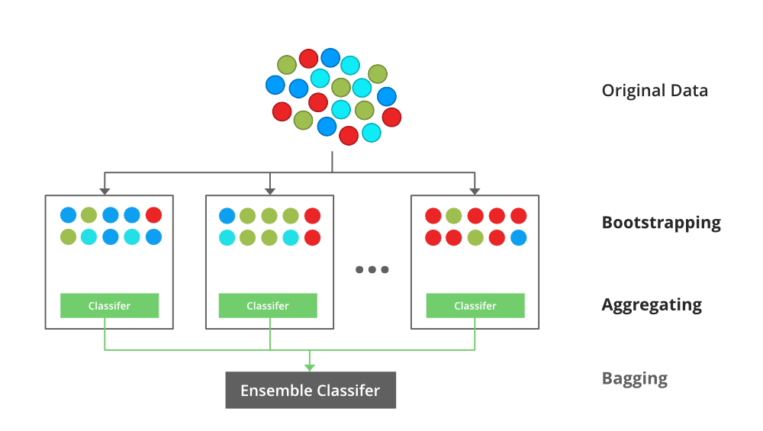

Slide 11
Boosting
Boosting is an ensemble modeling technique designed to create a strong classifier by combining multiple weak classifiers.
The process involves building models sequentially, where each new model aims to correct the errors made by the previous ones.
Initially, a model is built using the training data.
Subsequent models are then trained to address the mistakes of their predecessors.
Boosting assigns weights to the data points in the original dataset.
Higher weights: Instances that were misclassified by the previous model receive higher weights.
Lower weights: Instances that were correctly classified receive lower weights.
Training on weighted data: The subsequent model learns from the weighted dataset, focusing its attention on harder-to-learn examples (those with higher weights).

Slide 12
Boosting
This iterative process continues until:
The entire training dataset is accurately predicted, or
A predefined maximum number of models is reached.
AdaBoost was the first really successful boosting algorithm developed for the purpose of binary classification. AdaBoost is short for Adaptive Boosting and is a very popular boosting technique that combines multiple “weak classifiers” into a single “strong classifier”.

Slide 13
Boosting Algorithms
Initialise the dataset and assign equal weight to each of the data point.
Provide this as input to the model and identify the wrongly classified data points.
Increase the weight of the wrongly classified data points and decrease the weights of correctly classified data points. And then normalize the weights of all data points.
if (got required results) Goto step 5 else Goto step 2
End

Slide 14
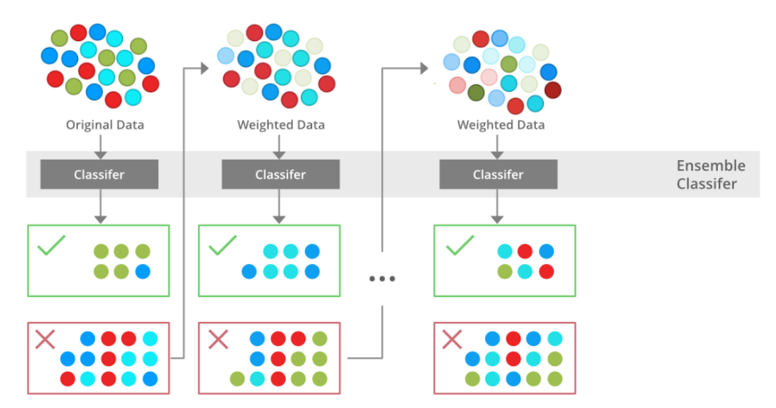

Slide 15
Similarities Between Bagging and Boosting
Both are ensemble methods to get N learners from 1 learner.
Both generate several training data sets by random sampling.
In Bagging, the final decision is made by averaging predictions or majority voting. In Boosting, new models focus on correcting previous errors, and the final decision is made by a weighted majority vote.
Both are good at reducing variance and provide higher stability.

Slide 16
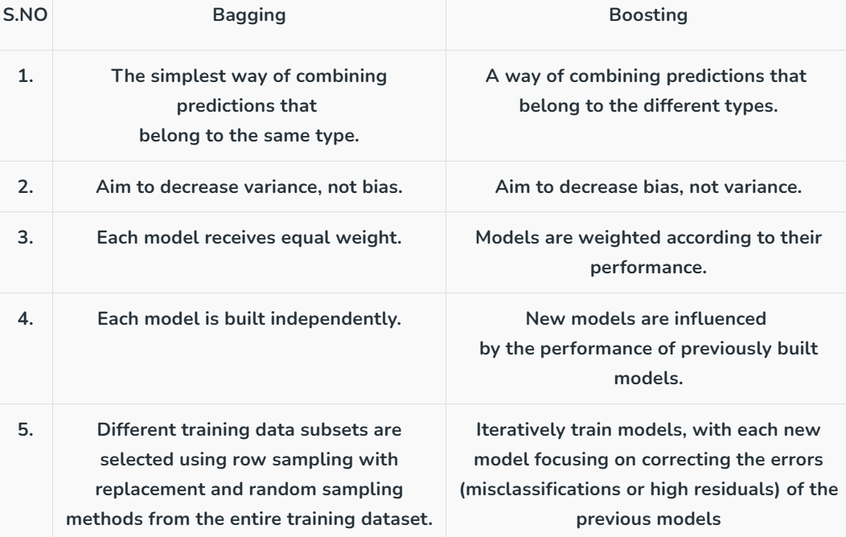

Slide 17
